Slide 1
AX-CPT Test OpenVibe
Made By
Pierre Boulet
Contact : bouletpier@cy-tech.fr

Slide 2
Download OpenVibe On Windows
Download OpenVibe Software following this link: http://openvibe.inria.fr/downloads/ Choose either 32/64bits
launch “install_dependencies.cmd” which you can find in root folder of source tree
launch “build.cmd” which you can find in root folder of source tree
You can find the official Build Page following this link for more information http://openvibe.inria.fr/build-instructions/

Slide 3
Required Python Packages
In the first place make sure your python path is accessible to OpenVibe
If the Python scripting box does not appear in the Scripting folder of the Designer boxes list, it’s because the Python environment was not found. To make sure OpenViBE finds it, do the following:
Open Control Panel -> System -> Advanced System Settings -> Environment Variables
Modify the Path variable: add the path to your python install to it (e.g. C:\Program Files\Python37)
Installing the packages
Download Pynput and Tkinter with the following command lines:
pip install pynput
pip install tk

Slide 4
Download AX-CPT folder
You can get the code files directly on my GitHub repository
https://github.com/PierreBoubou/AX-CPT-Test
I suggest creating a Data folder in the AX-CPT folder to organise Experiment Trials
!!! For the code to work you will need the writing access to the folder where the files are located !!!

Slide 5
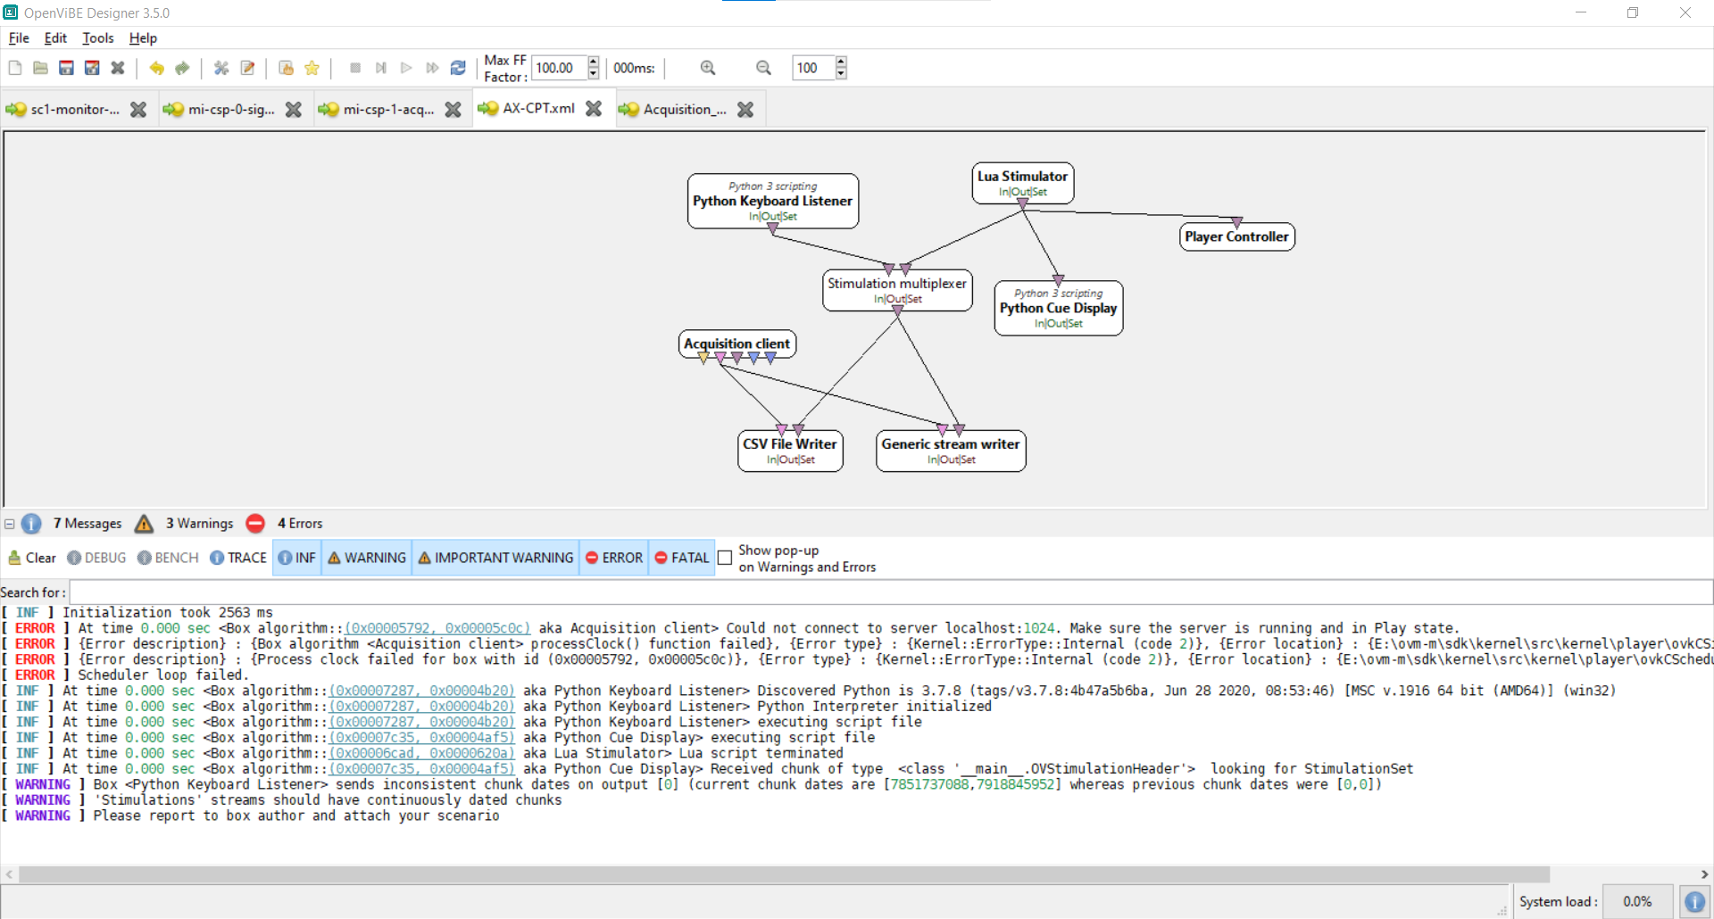
Configure The Experiment I
Launch OpenVibe Designer with “openvibe-designer.cmd” at the root of the OpenVibe Tree
Open “AX-CPT.xml” Here is what you should see:

Slide 6
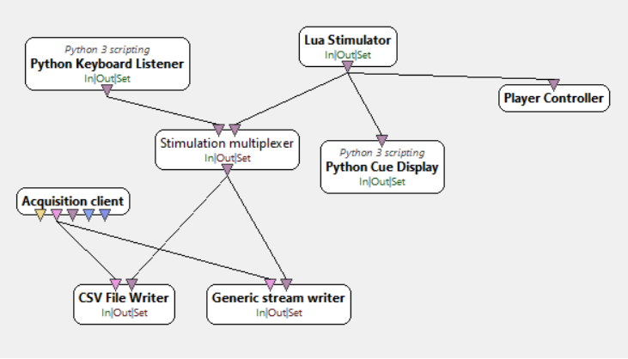
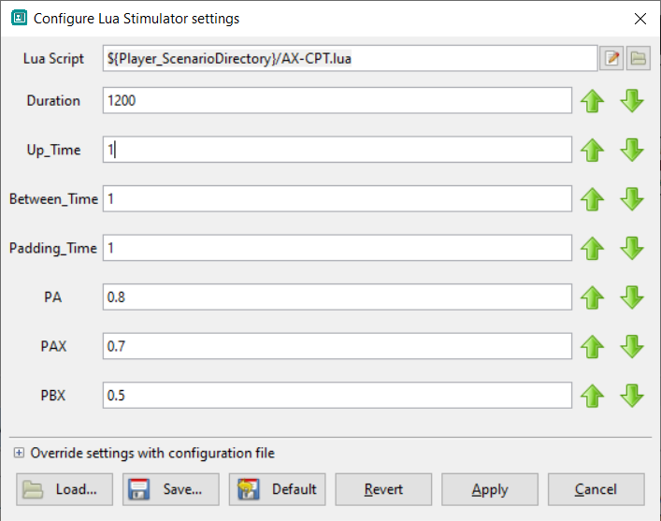
Configure The Experiment II
Double Click On “Lua Stimulator”
Fill the champs in the following way

Slide 7
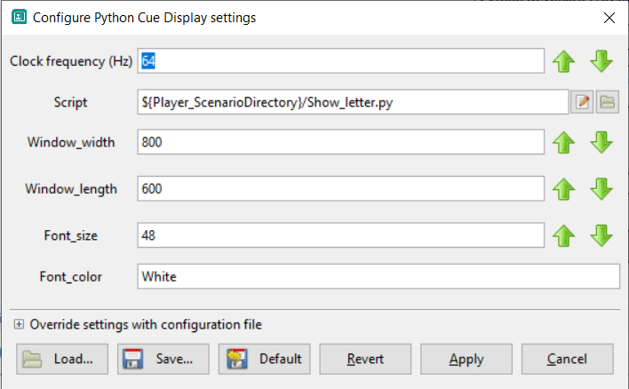
Configure The Experiment III
Double Click On “Python Cue Display”
You can change display at your will

Slide 8
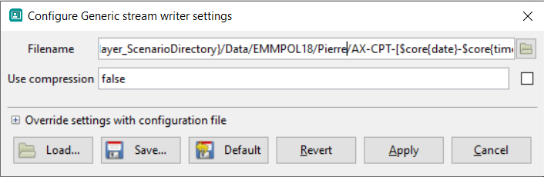
Configure File Writers I
Double Click On “Generic Stream Writer”
Set Filename as following:
${Player_ScenarioDirectory}/Data/MISSION/PRENOM-NOM/AX-CPT-[$core{date}-$core{time}].ov
!!! Folders have to be created manually before the code starts !!!

Slide 9
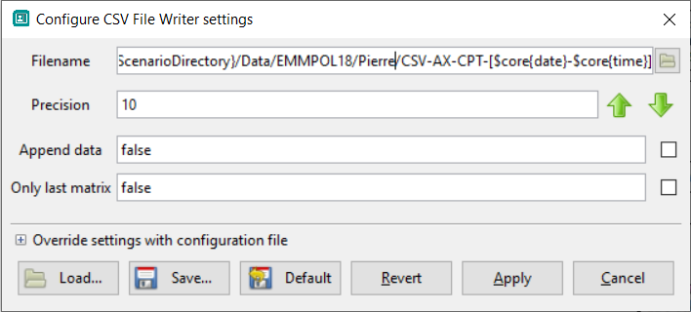
Configure File Writers II
Double Click On “CSV File Writer”
Set Filename as following:
${Player_ScenarioDirectory}/Data/MISSION/PRENOM-NOM/AX-CPT-[$core{date}-$core{time}].csv
!!! Folders and subfolders have to be created manually before the code starts !!!

Slide 10
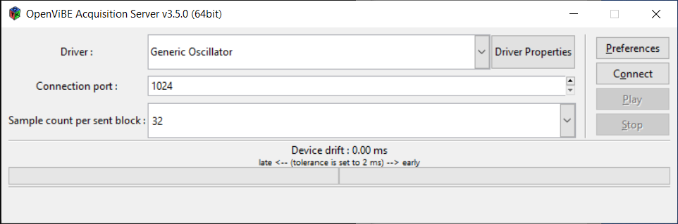
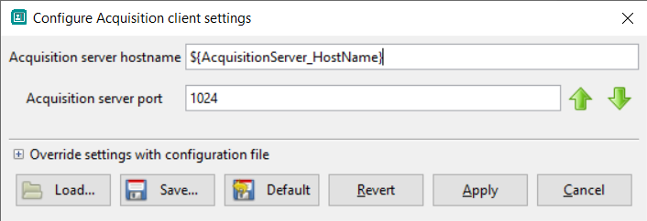
Configure Acquisition client
Launch OpenVibe Designer with “openvibe-acquisition-server.cmd” at the root of the OpenVibe Tree
Choose Your EEG Driver in the Driver list and Don’t change Defaults Settings
Make sure Connection port is the same as in the Designer’s Acquisition Client
The
Click Connect then Play. The acquisition should be Running

Slide 11
The AX- CPT Test
This test will Measure your attention and Reaction Time
You will be shown 4 differents cue : A,B:X,Y
These cue will arrive on screen one after another in these possible order A->X, A->Y, B->X or B->Y.
Your Goal is to press “Return” as fast as you can after seeing an X that has been preceded by an A and do nothing for every other cue.
A then X => Press “Return” B then X => Do Nothing
A then Y => Do Nothing B then Y => Do Nothing
Every time you press “Return” to fast to slow or simply don’t will count as faults

Slide 12
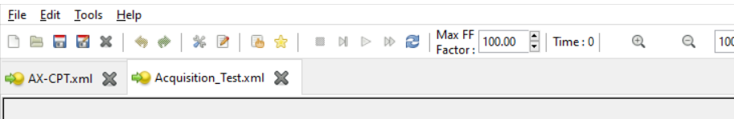
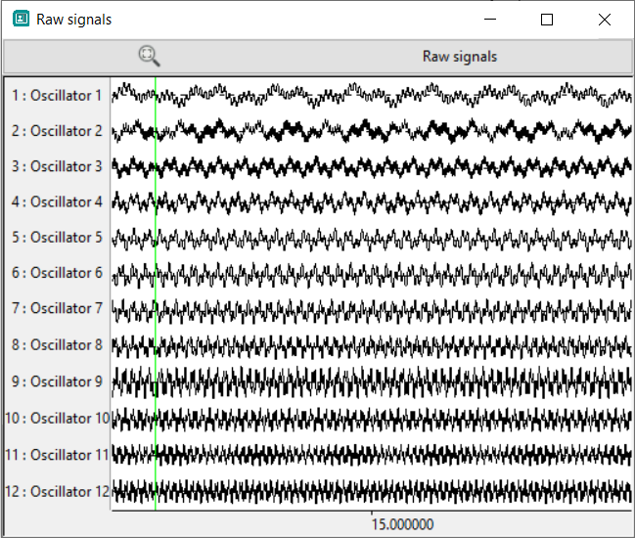
Starting the Test I
Investigate Data Quality after having started the acquisition server
Open “openvibe-designer.cmd” then open “Acquisition_Test.xml” and play it
Make sure signal is consistent
and clear.
No Signal Drops Nor Signal Diverging
If so check the electrode placement and impedance
There will be artifact if you flex your muscles blink
or move your eyeballs so try doing it the less possible
and try keeping your eyes focused on the screen

Slide 13
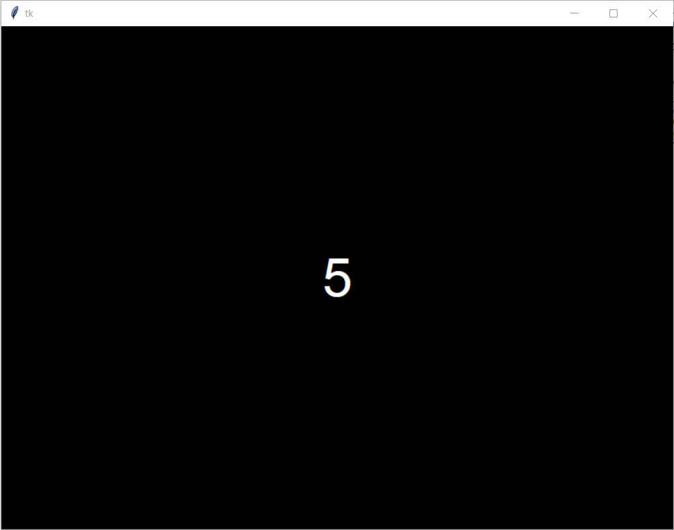
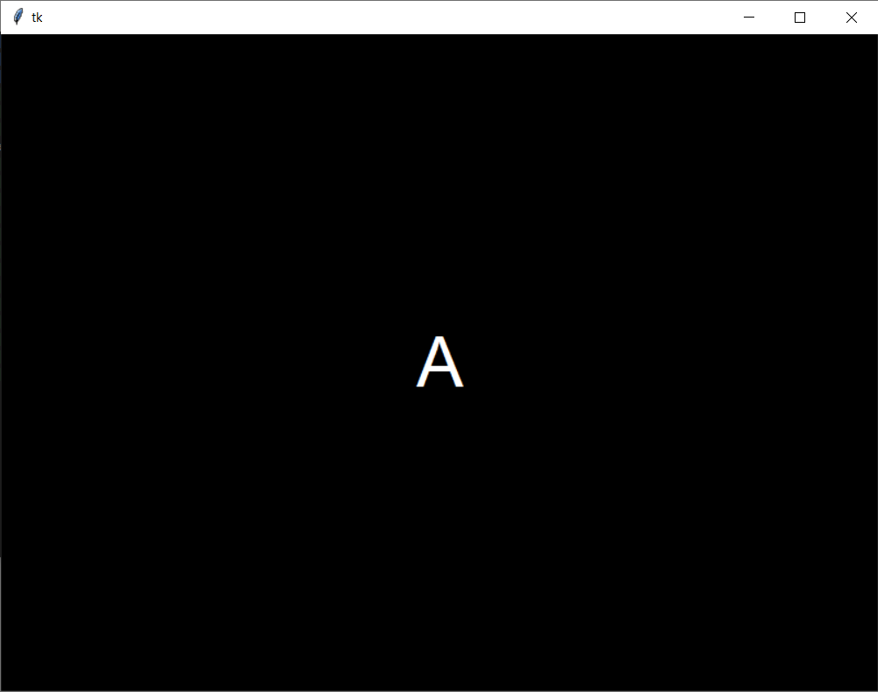
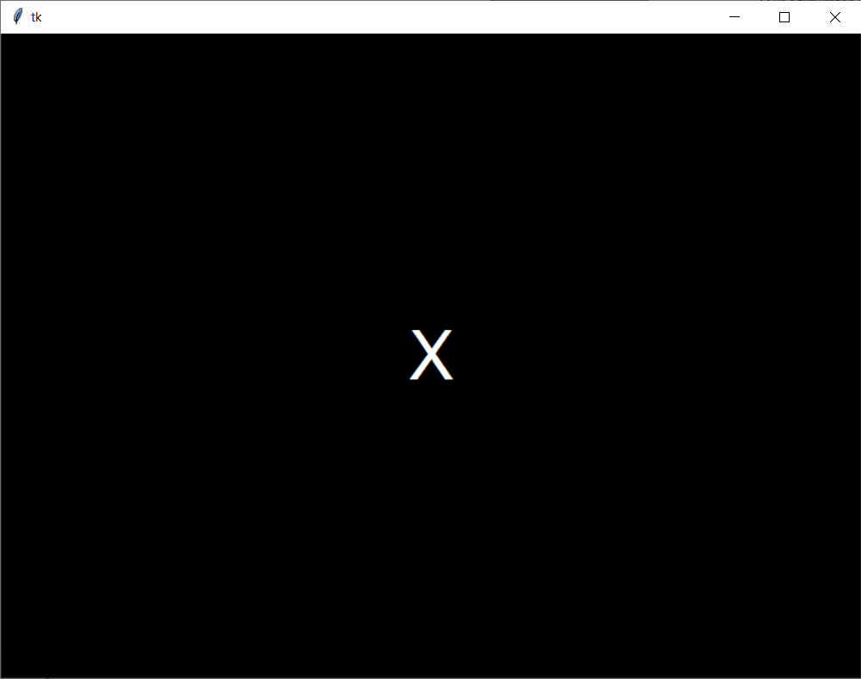
Starting the Test II
Open “openvibe-designer.cmd” then open “AX-CPT.xml”
Make sure that the Writers' Paths are set to your repertory and check the Test’s Parameters then Press Play
You will have a short time to get comfortable and ready the the test will start

Slide 14
Good Luck
Made By
Pierre Boulet
Contact : bouletpier@cy-tech.fr

